Slide 1



Planck's Cosmic Lenses
Nicholas Foo
University of Arizona, Research Advisor: Prof. Brenda Frye
NASA Space Grant Symposium
April 23, 2022

Slide 2
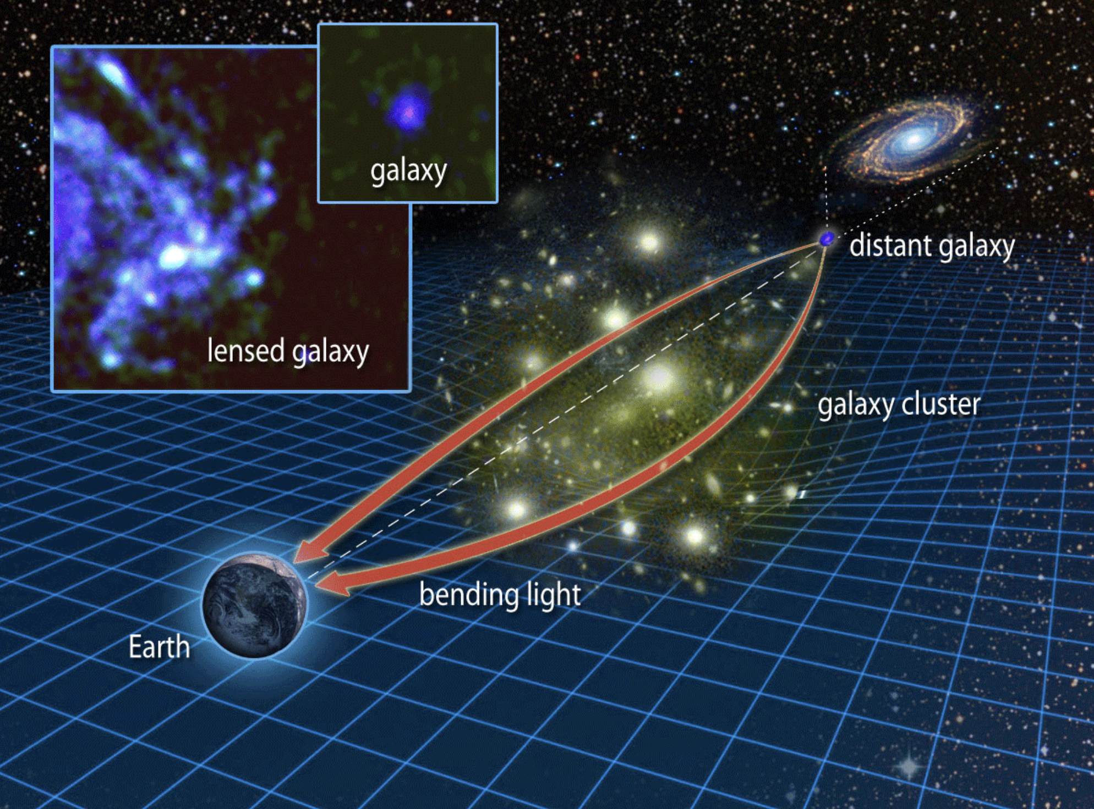
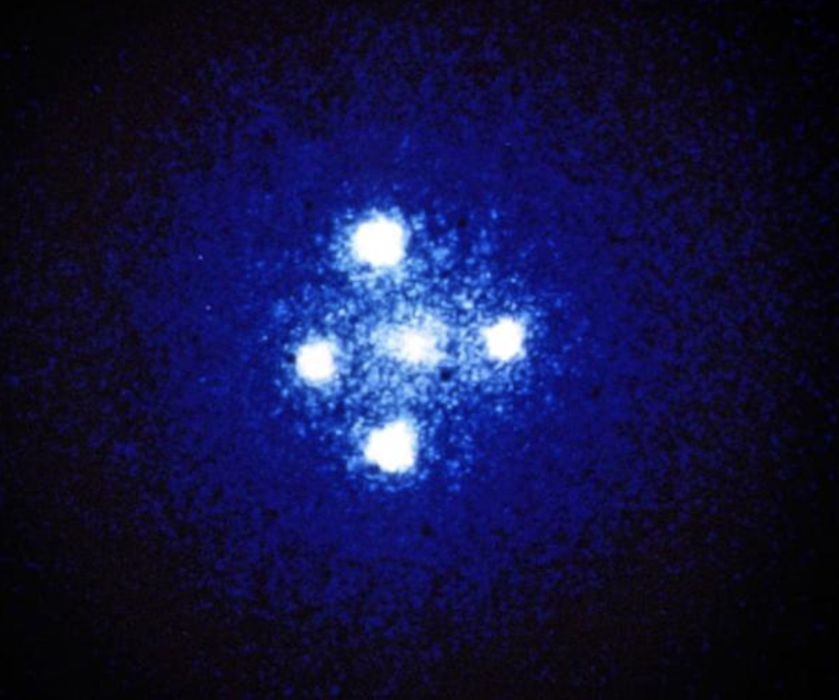
Gravitational Lensing
Massive objects warp spacetime
Path of light rays emitted in the background are perturbed
Images can be magnified, distorted, multiplied
Source: Hubble Space Telescope: John Huchra
Source: Institute for Astronomy, University of Hawaii

Slide 3
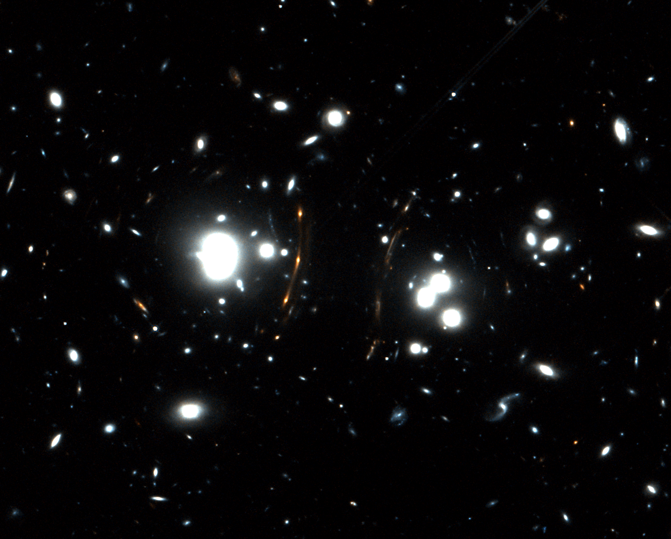
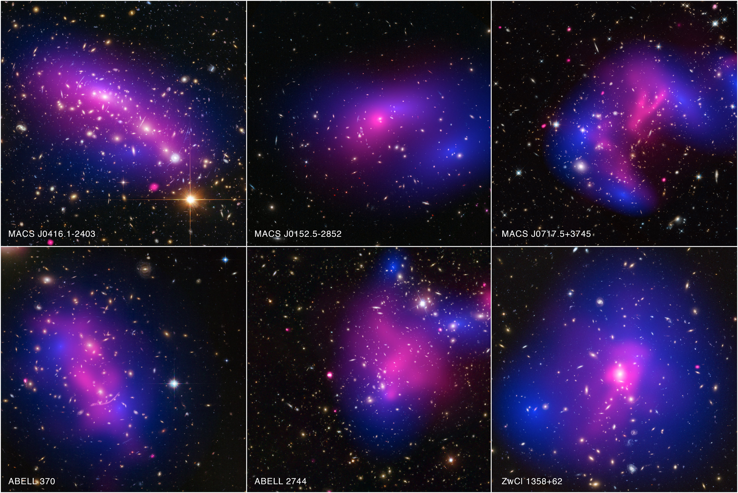
Cluster Lens Modeling
Source: Harvey et al. 2015
Image multiplicities allows us to construct lens models
Gravitational lensing is evidence of Dark Matter
Lens modeling is a powerful tool to probe the dominant dark matter haloes

Slide 4
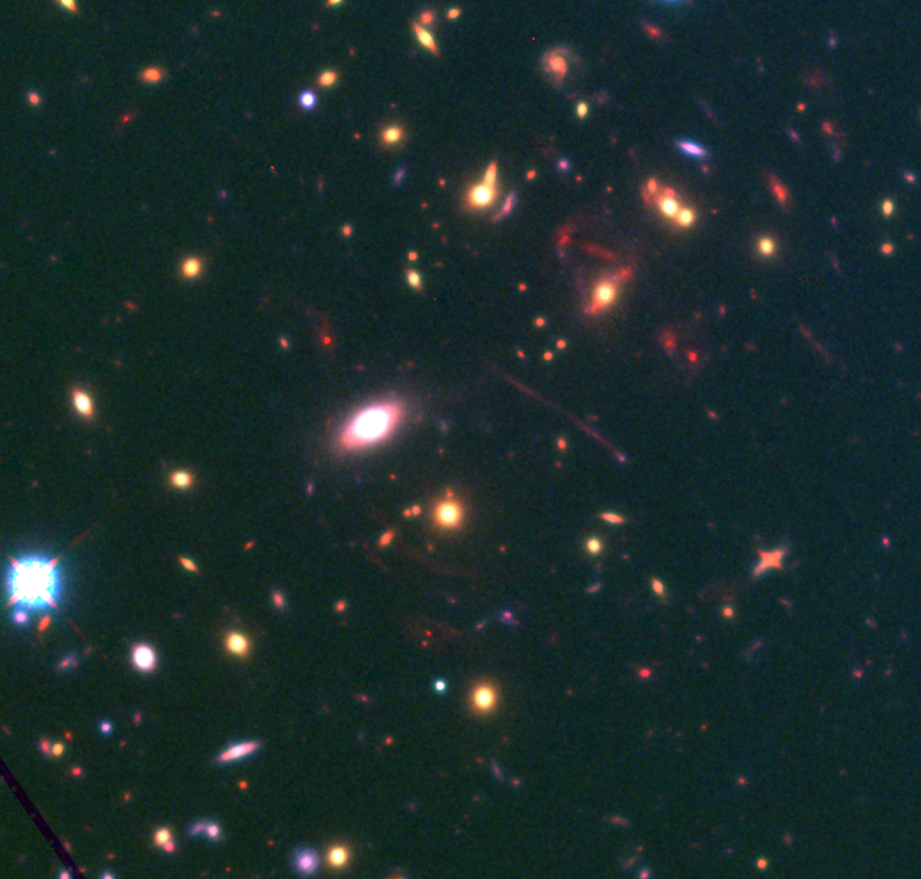
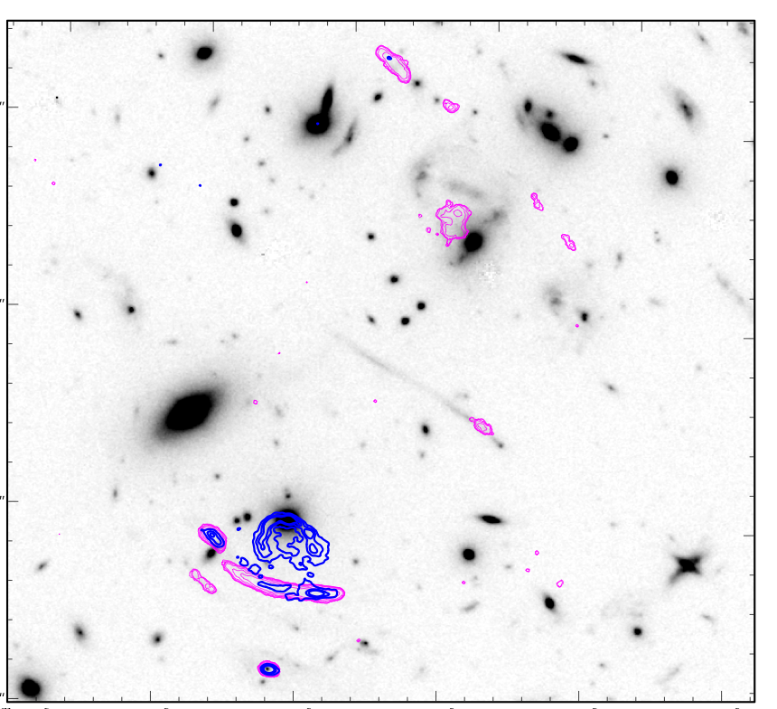
PJ084648.55 (J08) Cluster Field
J08 field consist of Atacama Large Millimeter Array (ALMA) radio detections at a high redshift (z=2.66)
Strongly lensed by foreground cluster
Dusty Star-forming Galaxies (DSFG) are extremely dusty, have very high star formation rate

Slide 5
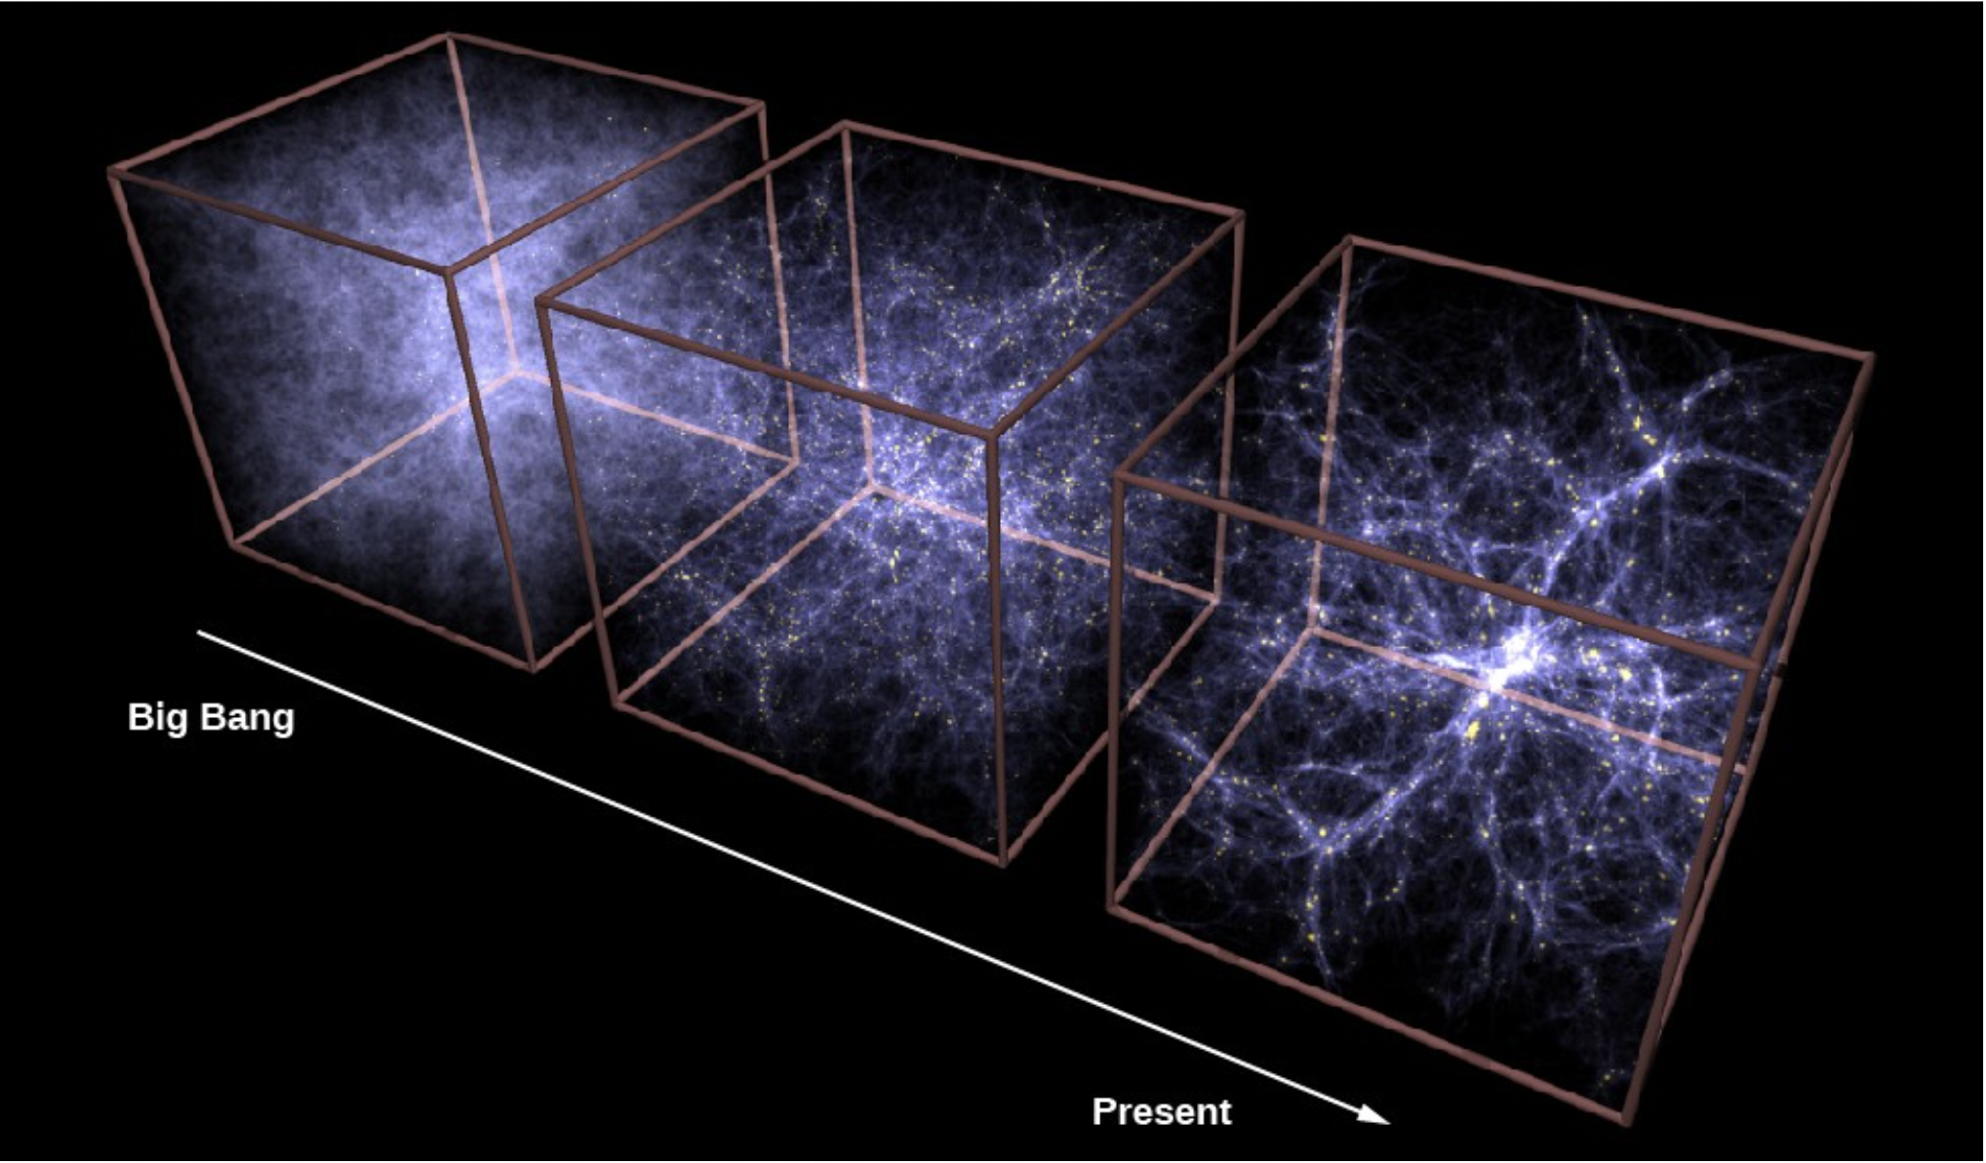
Protoclusters
Is the J08 field a strongly lensed DSFG protocluster?
Protoclusters: Region of over density, yet to form single dark matter halo, earlier in the universe
Source: CXC/MPE/V.Springel

Slide 6
Objectives
Is the J08 field a strongly lensed SMG protocluster?
Constructing a lens model can help us establish this:
  Confirm image systems
  Predict new images
  Constructs Magnification map
  Source plane reconstruction

Slide 7
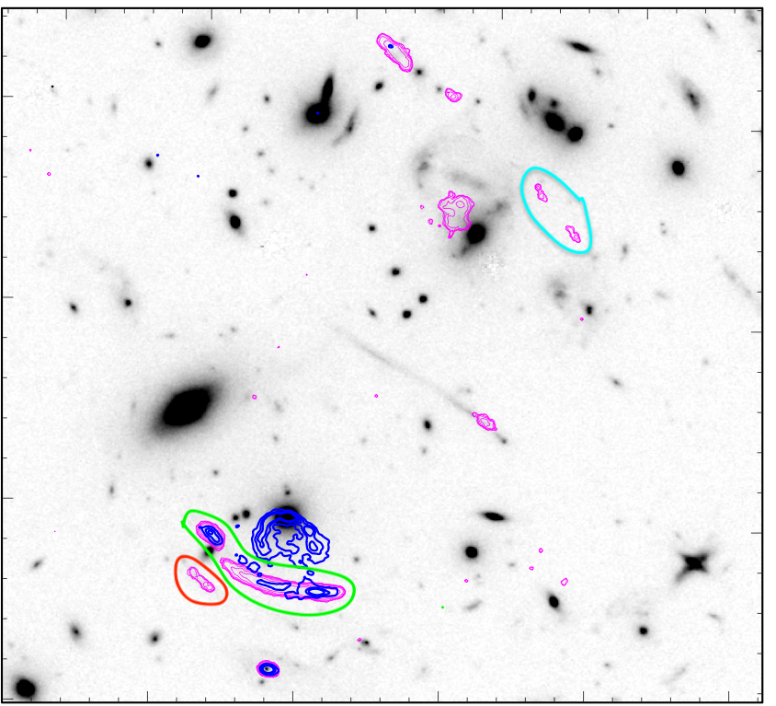
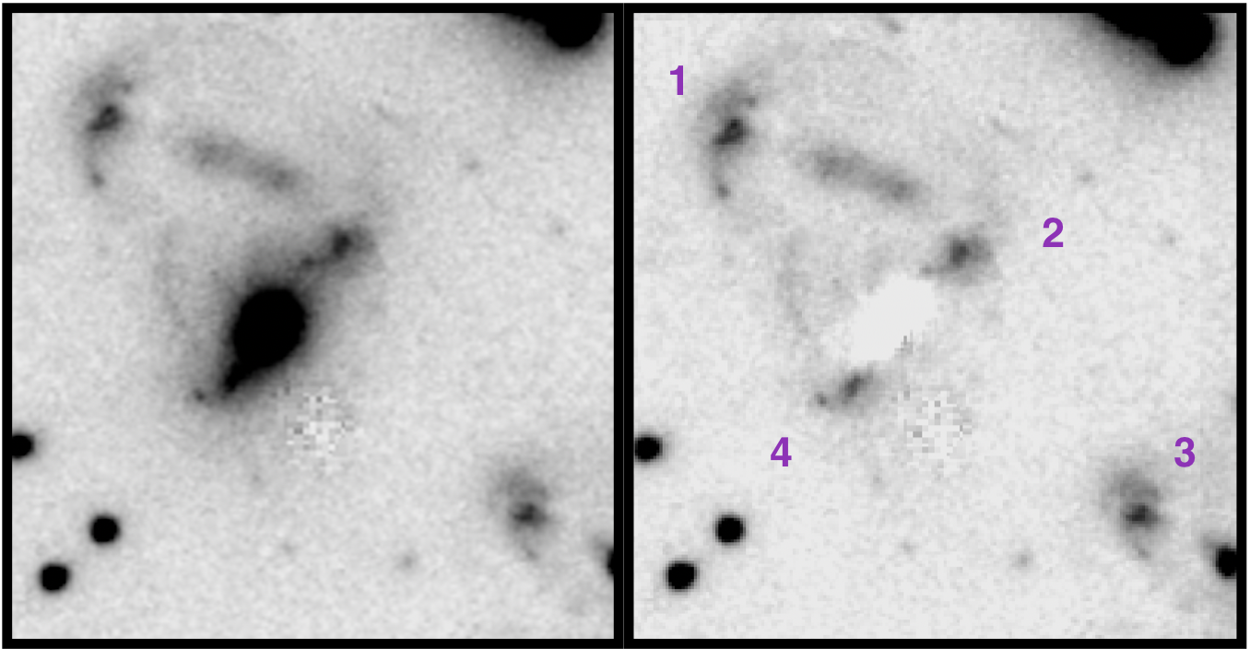
Image System
Image Identifications made from radio and Hubble Space Telescope observations
Establish which images are of the same galaxy
Constrain the lensing properties

Slide 8
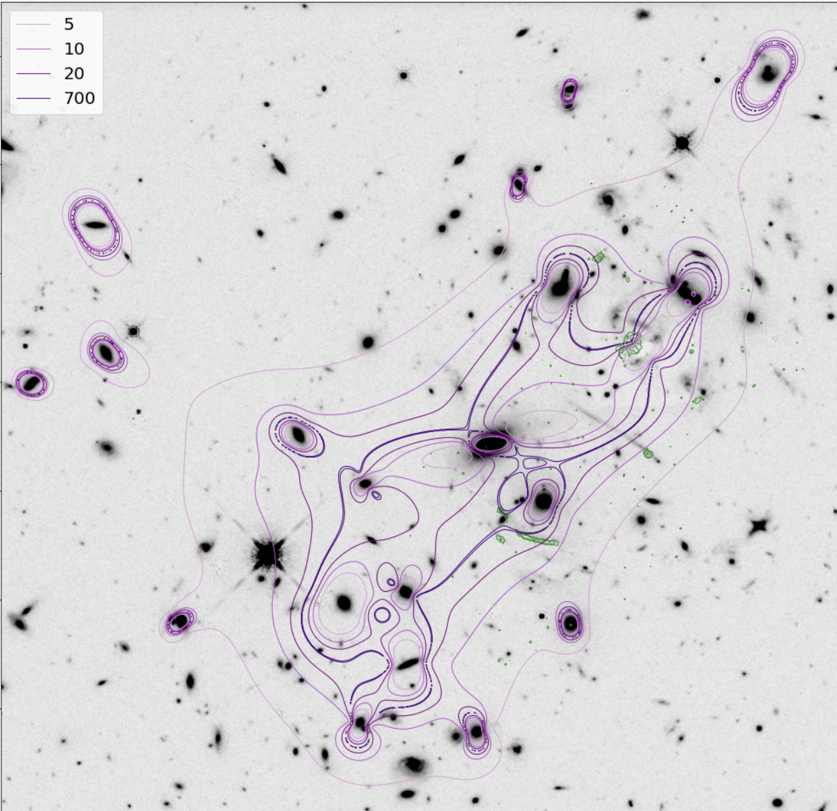
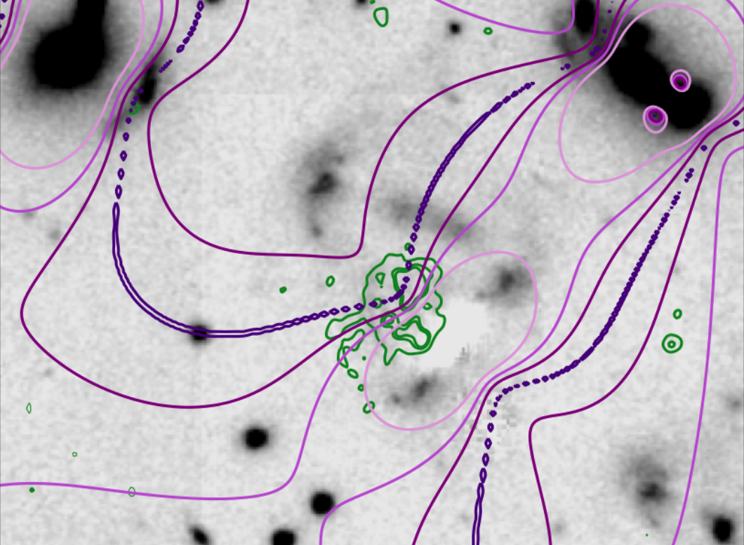
Magnification Model Map
Magnification Model Map for the cluster field
Why was this emission so spatially large at this high redshift?
predicts it is radially & tangentially magnified

Slide 9
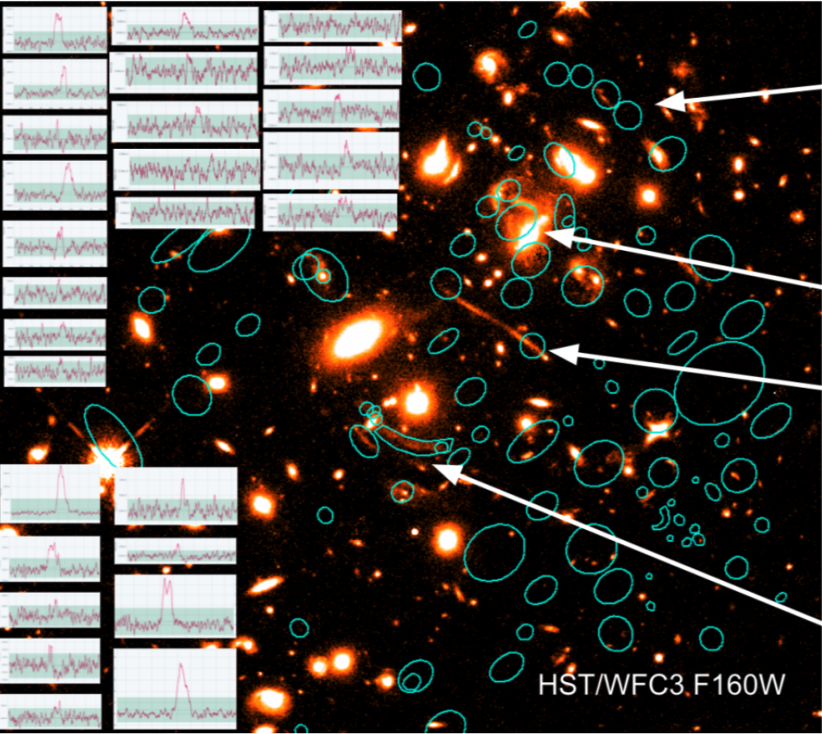
Conclusion
Model can reproduce several image systems, but not all radio detections are accounted for
New predicted images yet to be observed/confirmed
Future observational data help constrain lens model, providing redshifts
Source Plane reconstruction

Slide 10
Thank You
Special Thanks to:
Prof. Brenda Frye and the Planck & PASSAGES group
Arizona Space Grant Consortium
NASA Space Grant

